Slide 1
Additional User Defined Profile Testing

Slide 2
Objectives + Methodology
Examination of profile editor features to determine boundaries of feasibility
Isolate individual parameters capable of generating errors
Examine potential differences between airframes
Classify cause of errors: physical impossibility vs. theoretical impossibility
Separate analysis of bank angle + flap settings + thrust settings
Parameters tested separately to avoid effects of interaction
Similar settings tested across A320-211 + B737-800
Results compared to “standard” approach profile for evaluation

Slide 3
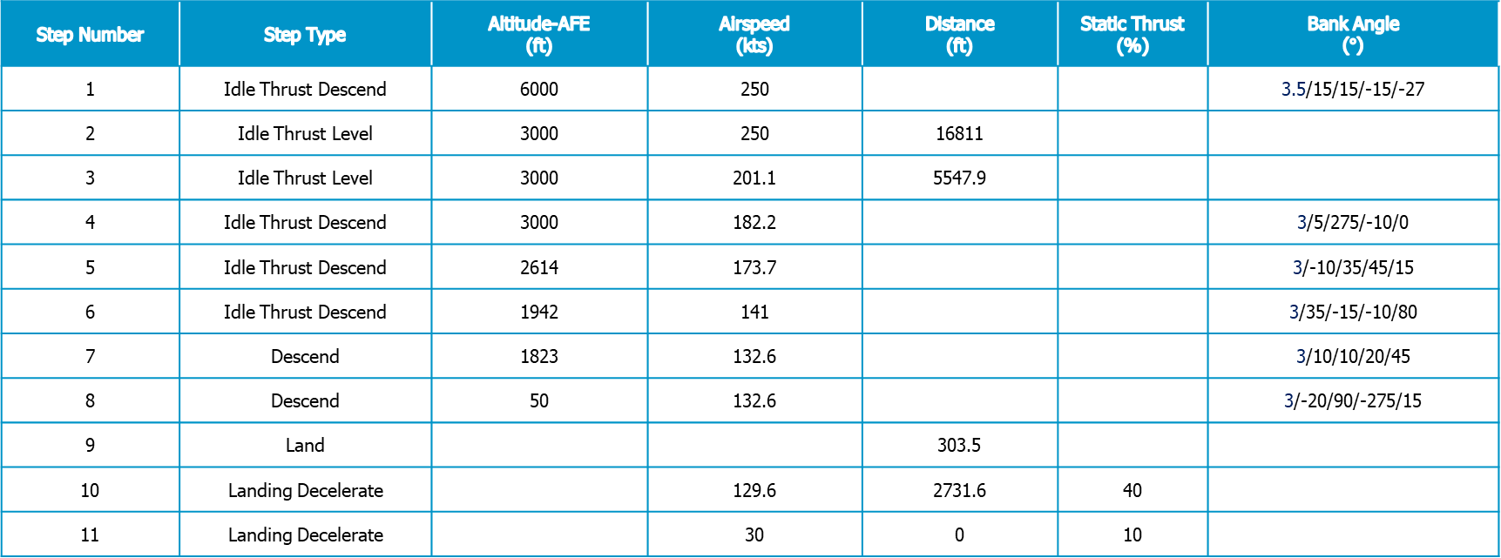
Examining Bank Angle
A320-211 + KATL + Arrival
Parameters ranging from mild deviations to extreme cases
AEDT error in all cases beyond standard configuration (both positive and negative offsets)
Rejection likely due to presence of negative angles
Step Number | Step Type | Altitude-AFE (ft) | Airspeed (kts) | Distance (ft) | Static Thrust (%) | Bank Angle ($°$)
1 | Idle Thrust Descend | 6000 | 250 |  |  | 3.5/15/15/-15/-27
2 | Idle Thrust Level | 3000 | 250 | 16811
3 | Idle Thrust Level | 3000 | 201.1 | 5547.9
4 | Idle Thrust Descend | 3000 | 182.2 |  |  | 3/5/275/-10/0
5 | Idle Thrust Descend | 2614 | 173.7 |  |  | 3/-10/35/45/15
6 | Idle Thrust Descend | 1942 | 141 |  |  | 3/35/-15/-10/80
7 | Descend | 1823 | 132.6 |  |  | 3/10/10/20/45
8 | Descend | 50 | 132.6 |  |  | 3/-20/90/-275/15
9 | Land |  |  | 303.5
10 | Landing Decelerate |  | 129.6 | 2731.6 | 40
11 | Landing Decelerate |  | 30 | 0 | 10

Slide 4
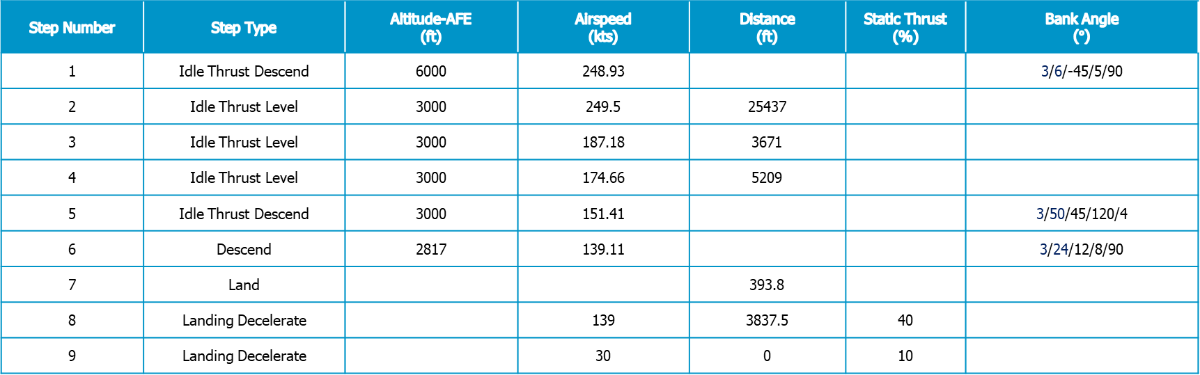
Examining Bank Angle
B737-800 + KATL + Arrival
Parameters ranging from mild deviations to extreme cases
AEDT allows exaggerated acute bank angles
Rejection of all right and obtuse bank angles
Step Number | Step Type | Altitude-AFE (ft) | Airspeed (kts) | Distance (ft) | Static Thrust (%) | Bank Angle ($°$)
1 | Idle Thrust Descend | 6000 | 248.93 |  |  | 3/6/-45/5/90
2 | Idle Thrust Level | 3000 | 249.5 | 25437
3 | Idle Thrust Level | 3000 | 187.18 | 3671
4 | Idle Thrust Level | 3000 | 174.66 | 5209
5 | Idle Thrust Descend | 3000 | 151.41 |  |  | 3/50/45/120/4
6 | Descend | 2817 | 139.11 |  |  | 3/24/12/8/90
7 | Land |  |  | 393.8
8 | Landing Decelerate |  | 139 | 3837.5 | 40
9 | Landing Decelerate |  | 30 | 0 | 10

Slide 5
Comparing Bank Angles
737-800 profile variations due to bank angle changes examined
Bank angle increase facilitates faster approach
Conforms to physical expectations

Slide 6
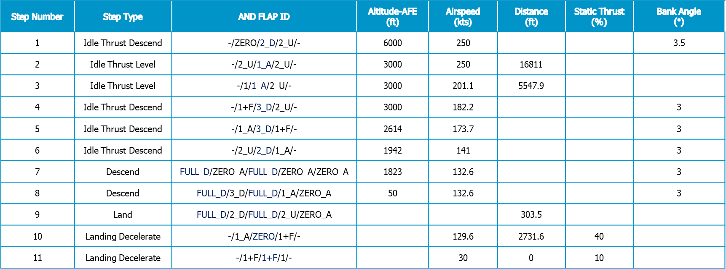
Examining Flap Settings
A320-211 + KATL + Arrival
Parameters ranging from deviations within expected flap type to incorrect configurations
AEDT error in all cases except “standard” and minimal deviation
Errors due to use of “2_U” during descent + “ZERO_A” during descent and land
Step Number | Step Type | AND FLAP ID | Altitude-AFE (ft) | Airspeed (kts) | Distance (ft) | Static Thrust (%) | Bank Angle ($°$)
1 | Idle Thrust Descend | -/ZERO/2_D/2_U/- | 6000 | 250 |  |  | 3.5
2 | Idle Thrust Level | -/2_U/1_A/2_U/- | 3000 | 250 | 16811
3 | Idle Thrust Level | -/1/1_A/2_U/- | 3000 | 201.1 | 5547.9
4 | Idle Thrust Descend | -/1+F/3_D/2_U/- | 3000 | 182.2 |  |  | 3
5 | Idle Thrust Descend | -/1_A/3_D/1+F/- | 2614 | 173.7 |  |  | 3
6 | Idle Thrust Descend | -/2_U/2_D/1_A/- | 1942 | 141 |  |  | 3
7 | Descend | FULL_D/ZERO_A/FULL_D/ZERO_A/ZERO_A | 1823 | 132.6 |  |  | 3
8 | Descend | FULL_D/3_D/FULL_D/1_A/ZERO_A | 50 | 132.6 |  |  | 3
9 | Land | FULL_D/2_D/FULL_D/2_U/ZERO_A |  |  | 303.5
10 | Landing Decelerate | -/1_A/ZERO/1+F/- |  | 129.6 | 2731.6 | 40
11 | Landing Decelerate | -/1+F/1+F/1/- |  | 30 | 0 | 10

Slide 7
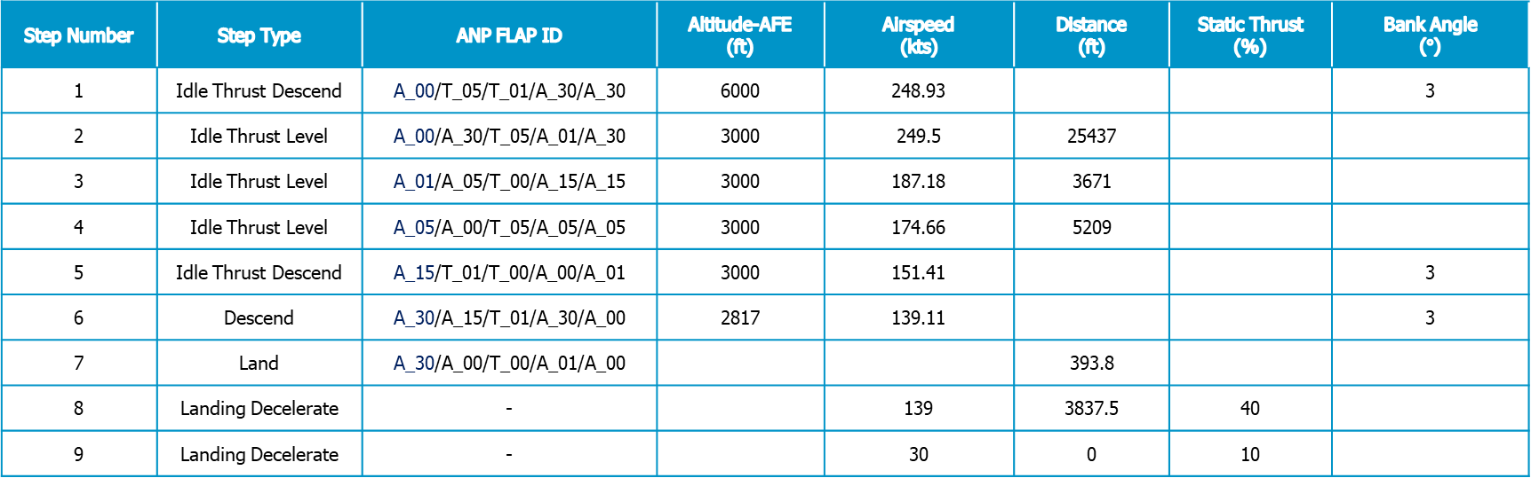
Examining Flap Settings
B737-800 + KATL + Arrival
Parameters ranging from mild deviations to extreme cases
Error when substituting take-off for landing flaps
Error when substituting high-angle configurations for low-angle + level flight
Rejection of all user-defined cases
Step Number | Step Type | ANP FLAP ID | Altitude-AFE (ft) | Airspeed (kts) | Distance (ft) | Static Thrust (%) | Bank Angle ($°$)
1 | Idle Thrust Descend | A_00/T_05/T_01/A_30/A_30 | 6000 | 248.93 |  |  | 3
2 | Idle Thrust Level | A_00/A_30/T_05/A_01/A_30 | 3000 | 249.5 | 25437
3 | Idle Thrust Level | A_01/A_05/T_00/A_15/A_15 | 3000 | 187.18 | 3671
4 | Idle Thrust Level | A_05/A_00/T_05/A_05/A_05 | 3000 | 174.66 | 5209
5 | Idle Thrust Descend | A_15/T_01/T_00/A_00/A_01 | 3000 | 151.41 |  |  | 3
6 | Descend | A_30/A_15/T_01/A_30/A_00 | 2817 | 139.11 |  |  | 3
7 | Land | A_30/A_00/T_00/A_01/A_00 |  |  | 393.8
8 | Landing Decelerate | - |  | 139 | 3837.5 | 40
9 | Landing Decelerate | - |  | 30 | 0 | 10

Slide 8
Comparing Flap Settings
A320-211 profile variations due to flap changes examined
Changes in flap configuration have no impact on flight profile
Implies steps 7-9 of standard profile play most important role in flap impact

Slide 9
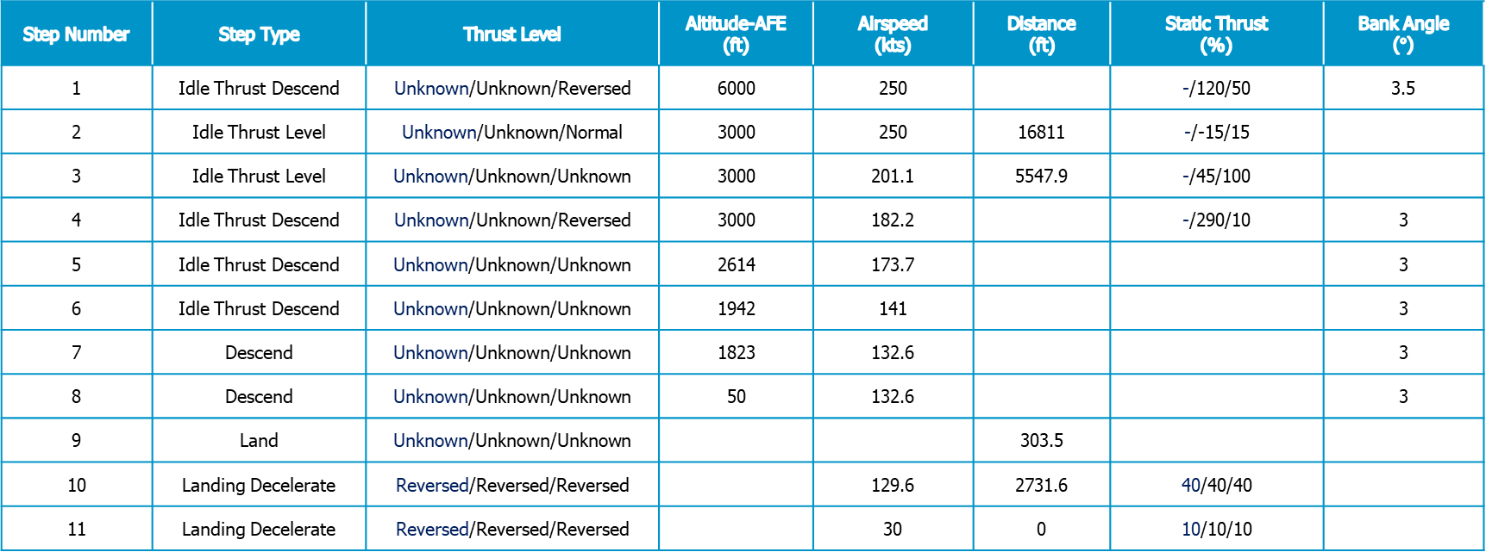
Examining Thrust Settings
A320-211 + KATL + Arrival
Variations in thrust level and/or static thrust
Error across all new configurations
Rejection of large positive + negative + wide variation from standard thrust
Step Number | Step Type | Thrust Level | Altitude-AFE (ft) | Airspeed (kts) | Distance (ft) | Static Thrust (%) | Bank Angle ($°$)
1 | Idle Thrust Descend | Unknown/Unknown/Reversed | 6000 | 250 |  | -/120/50 | 3.5
2 | Idle Thrust Level | Unknown/Unknown/Normal | 3000 | 250 | 16811 | -/-15/15
3 | Idle Thrust Level | Unknown/Unknown/Unknown | 3000 | 201.1 | 5547.9 | -/45/100
4 | Idle Thrust Descend | Unknown/Unknown/Reversed | 3000 | 182.2 |  | -/290/10 | 3
5 | Idle Thrust Descend | Unknown/Unknown/Unknown | 2614 | 173.7 |  |  | 3
6 | Idle Thrust Descend | Unknown/Unknown/Unknown | 1942 | 141 |  |  | 3
7 | Descend | Unknown/Unknown/Unknown | 1823 | 132.6 |  |  | 3
8 | Descend | Unknown/Unknown/Unknown | 50 | 132.6 |  |  | 3
9 | Land | Unknown/Unknown/Unknown |  |  | 303.5
10 | Landing Decelerate | Reversed/Reversed/Reversed |  | 129.6 | 2731.6 | 40/40/40
11 | Landing Decelerate | Reversed/Reversed/Reversed |  | 30 | 0 | 10/10/10

Slide 10
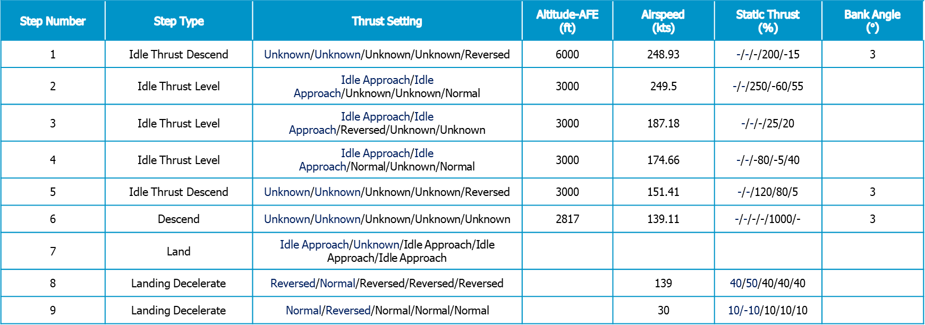
Examining Thrust Settings
B737-800 + KATL + Arrival
Variations in thrust level and/or static thrust
Rejection of static thrust > 100%
Acceptance of other variations in setting and static thrust
Step Number | Step Type | Thrust Setting | Altitude-AFE (ft) | Airspeed (kts) | Static Thrust (%) | Bank Angle ($°$)
1 | Idle Thrust Descend | Unknown/Unknown/Unknown/Unknown/Reversed | 6000 | 248.93 | -/-/-/200/-15 | 3
2 | Idle Thrust Level | Idle Approach/Idle Approach/Unknown/Unknown/Normal | 3000 | 249.5 | -/-/250/-60/55
3 | Idle Thrust Level | Idle Approach/Idle Approach/Reversed/Unknown/Unknown | 3000 | 187.18 | -/-/-/25/20
4 | Idle Thrust Level | Idle Approach/Idle Approach/Normal/Unknown/Normal | 3000 | 174.66 | -/-/-80/-5/40
5 | Idle Thrust Descend | Unknown/Unknown/Unknown/Unknown/Reversed | 3000 | 151.41 | -/-/120/80/5 | 3
6 | Descend | Unknown/Unknown/Unknown/Unknown/Unknown | 2817 | 139.11 | -/-/-/-/1000/- | 3
7 | Land | Idle Approach/Unknown/Idle Approach/Idle Approach/Idle Approach
8 | Landing Decelerate | Reversed/Normal/Reversed/Reversed/Reversed |  | 139 | 40/50/40/40/40
9 | Landing Decelerate | Normal/Reversed/Normal/Normal/Normal |  | 30 | 10/-10/10/10/10

Slide 11
Comparing Thrust Settings
B737-800 profile variations due to thrust settings examined
Thrust settings do not influence trajectory or speed profiles
Thrust plots mimic settings shown in previous table
“Unknown” thrust segments match despite changes elsewhere

Slide 12
Conclusions
AEDT is capable of preventing all physically impossible cases
Negative thrust impossible barring reverse thrust settings
Previous tests show impossibility of conflicting segment instructions (e.g. altitude increase during descent)
AEDT usually prevents theoretically impossible cases
Error during right and obtuse bank angle implementation
Error during improper flap (and flap angle) deployments
Error during high thrust cases
Changes due to unconventional profiles sometimes in line with expectations
Bank angle increase hastens descent as expected
Flap changes have no impact on trajectory or speed
Changes in thrust reflected on corresponding plot
AEDT is generally adept at preventing the implementation of impossible cases but might be handling the effects of flap deployment in unexpected ways

